Slide 1


Green Pace
Security Policy Presentation
Developer: Amanda Purnhagen

Slide 2

OVERVIEW: DEFENSE IN DEPTH
The Green Pace Secure Development Policy was created to provide a common resource that documents the company’s high security standards. We expect employees to meet the policies and standards included in this presentation to maintain our overarching policy of defense-in-depth.

Slide 3
THREATS MATRIX
Red
Severe threat
Orange
Medium threat
Yellow
Low threat
Likely | Priority
Low priority | Unlikely
STD-004-CPP SQL Injection
STD-008-CPP Deserialization
STD-009-CPP External libraries
STD-010-CPP Privileges
STD-005-CPP Memory protection
STD-006-CPP Assertions
STD-001-CPP Data type
STD-007-CPP Exceptions
STD-002-CPP Data value
STD-003-CPP String correctness

Slide 4
10 PRINCIPLES
Validate input data:
STD-001-CPP Data type
STD-002-CPP Data value
STD-003-CPP String correctness
STD-004-CPP SQL injection
STD-008-CPP Deserialization
Heed compiler warning
STD-002-CPP Data value
STD-003-CPP String correctness
Default deny:
STD-004-CPP SQL injection
STD-008-CPP Deserialization
STD-010-CPP Privileges
Adhere to the Principle of Least Privilege:
STD-010-CPP Privileges
Sanitize data sent to other systems:
STD-008-CPP Deserialization
Use effective quality assurance techniques:
STD-006-CPP Assertions
STD-007-CPP Exceptions
STD-009-CPP External libraries
Adopt a secure coding standard:
STD-005-CPP Memory protection
STD-006-CPP Assertions
STD-007-CPP Exceptions

Slide 5
CODING STANDARDS
STD-004-CPP SQL injection
STD-009-CPP External libraries
STD-008-CPP Deserialization
STD-010-CPP Privileges
STD-005-CPP Memory protection
STD-006-CPP Assertions
STD-007-CPP Exceptions
STD-001-CPP Data type
STD-002-CPP Data value
STD-003-CPP String correctness

Slide 6
ENCRYPTION POLICIES
What types of data exist at Green Pace, and how are they obfuscated?
Encryption at rest
Password protected required
Encryption in flight
Asymmetric encryption recommended
Encryption in use
Encryption compatible with system applications
(Encryption: Understanding data at rest vs. in transit 2021).

Slide 7
TRIPLE-A POLICIES
How does Green Pace implement AAA Security?
Authentication
Credentials must be reentered after 30 minutes of inactivity. Computers should be locked when an employee walks away from their desk. Passwords must be sufficiently strong and changed every 6 months.
Authorization
Our system administrators have meticulously designed the Green Pace user groups. Employees are not allowed access to data deemed more sensitive than is necessary for their user group. Rare exceptions must be approved by the department’s director.
Accounting
The logging system must have redundancies and run 24/7. All user activity is monitored both by automatic flagging software and regularly scheduled manual spot checks.

Slide 8
Unit Testing
How can employees at Green Pace use unit testing to check code for unexpected behavior?

Slide 9
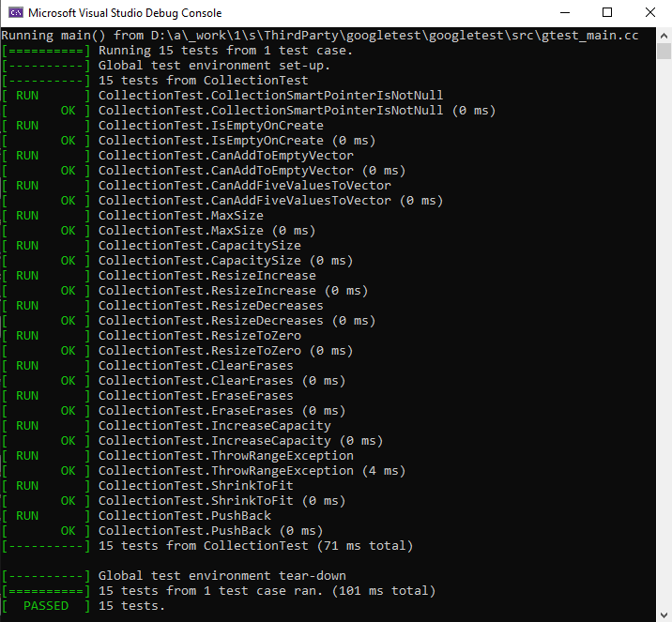
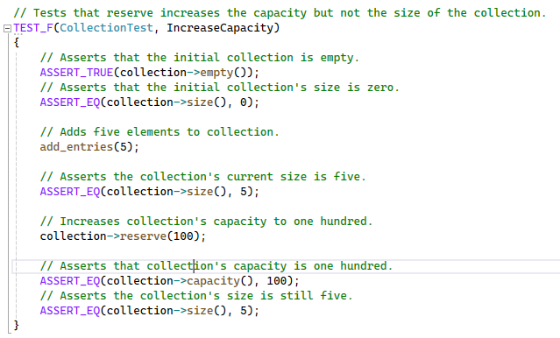


Has the collection’s reserve increased, and its size stayed the same?

Slide 10
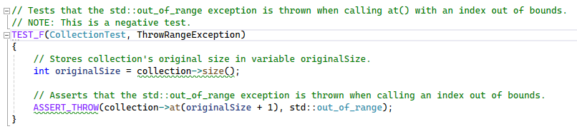


Is an exception thrown when an index out of bounds for the collection is accessed?

Slide 11
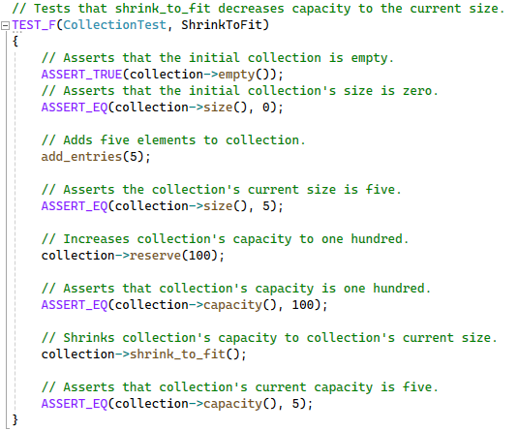

Does the shrink_to_fit() method decrease the collection’s capacity to its current size?

Slide 12
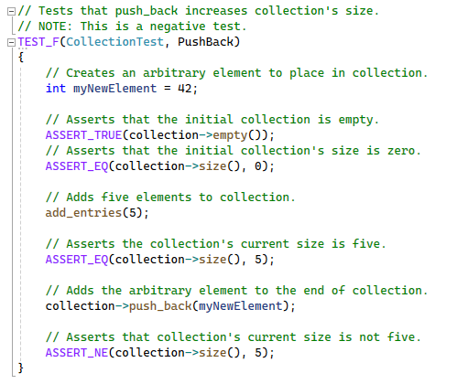

Does the push_back() function increase the collection’s size?

Slide 13

AUTOMATION SUMMARY

Slide 14
TOOLS
Assess and plan
Write custom code rules
Choose external custom code rules
Map out potential tests required
Design
What security best practices should be kept in mind throughout?
What unit tests will be required?
Build
Use the compiler to your advantage and heed compiler warnings
Verify and test
Unit tests are run, code rule compliance is verified
Transition and health check
Check security settings of deployed version
Is a penetration test necessary?
Monitor and detect
Activities are logged
Potential vulnerabilities are flagged
Respond / Maintain and stabilize
High risk vulnerabilities? Shut down services until a stable state is restored

Slide 15
RISKS AND BENEFITS
It’s probably fine. Let’s wait!
Black-hat hackers never wait
They’re figuring out where system data might be, OR
They’re already tirelessly pushing system limits to break in
Constant influx of new vulnerabilities
Waiting before patching a vulnerability gives malicious actors more time to gain system access
Let’s enforce security today!
A zero-trust policy is the best policy
Guarding client data is a huge responsibility
Constant vigilance
A critical eye
Creative thinking
Continued learning
Suggestions are valued and highly encouraged!

Slide 16
RECOMMENDATIONS
Green Pace Continued Learning
Security suggestions are welcome and encouraged!
There is always room for improvement
Current gaps
Detailed red-team penetration testing schedule

Slide 17
CONCLUSIONS
Green Pace standards that can prevent future problems
We are all responsible for Green Pace’s exceptional cybersecurity reputation
Bookmark a vulnerability database like the National Vulnerability Database (Search vulnerability database)
Constant practice

Slide 18
REFERENCES
Encryption: Understanding data at rest vs. in transit. DataLocker Inc. (2021, September 24). https://datalocker.com/blog/technology/encryption/encryption-at-rest-vs-in-transit-effectively-encrypt-identifiable-information/
National Institute of Standards and Technology. (n.d.). Search vulnerability database. National Vulnerability Database. https://nvd.nist.gov/vuln/search

